Slide 1

Predicting customer buying behaviour
30/5/2024

Slide 2
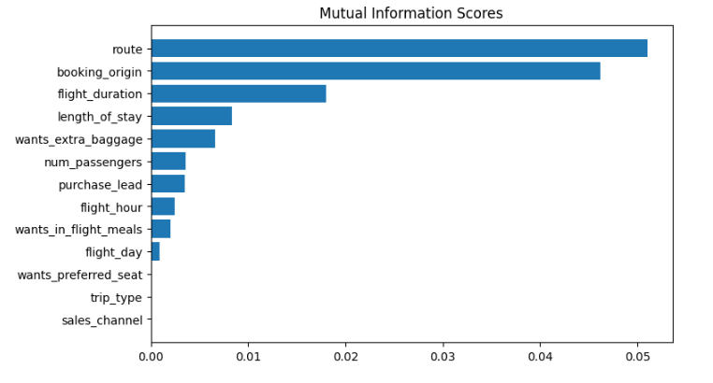
predictive model to understand factors that influence buying behavior
We have trained the data set with Random forest classifier model and received
ACCURACY: 85.09
AUC SCORE: 0.558
ROUTE
BOOKING_ORIGIN
FLIGHT_DURATION
WANTS_EXTRA_BAGGAGE
LENGTH_OF_STAY
Top 5 features which influence
Customer buying behavior
We need to increase the AUC score.

